Slide 1
Use Delta Lake in Azure Databricks
https://microsoftlearning.github.io/mslearn-databricks/Instructions/Exercises/LA-04-Explore-Delta-Lake.html

Slide 2
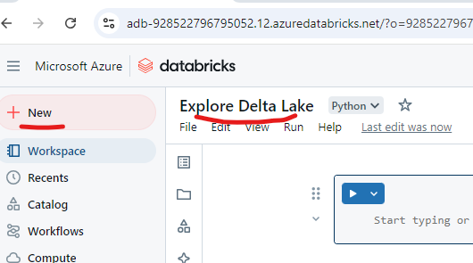

Slide 3
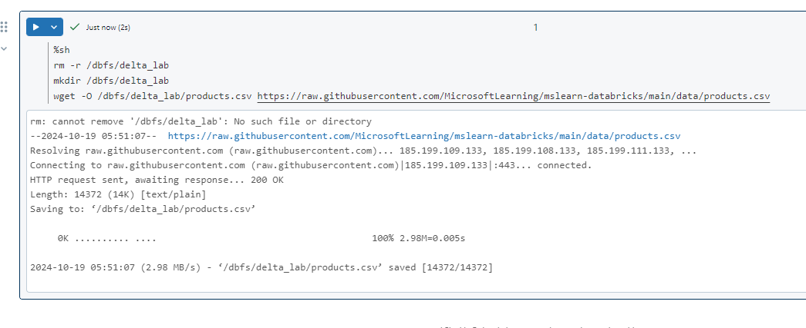

Slide 4
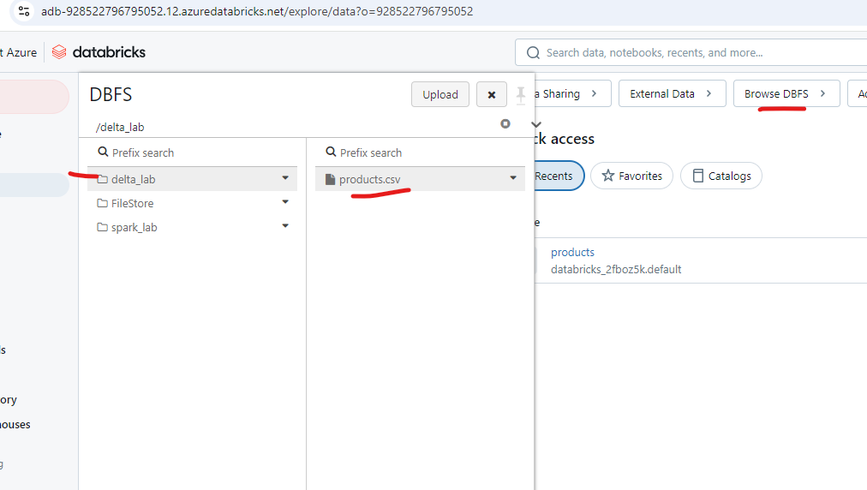

Slide 5
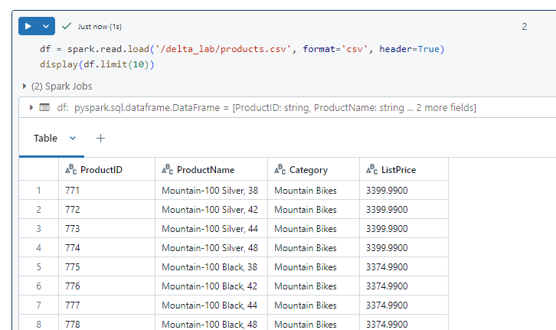

Slide 6
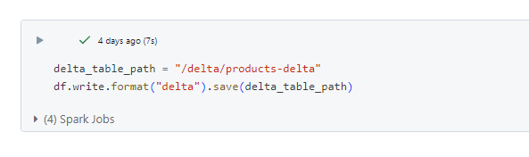

Slide 7

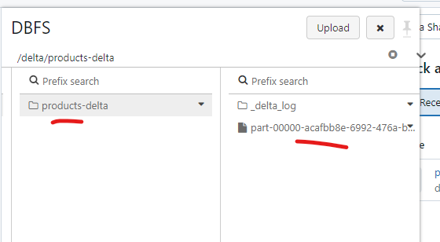

Slide 8
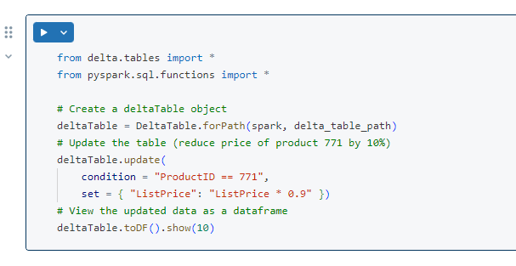

Slide 9
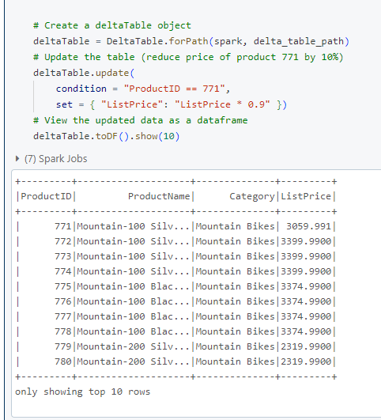

Slide 10
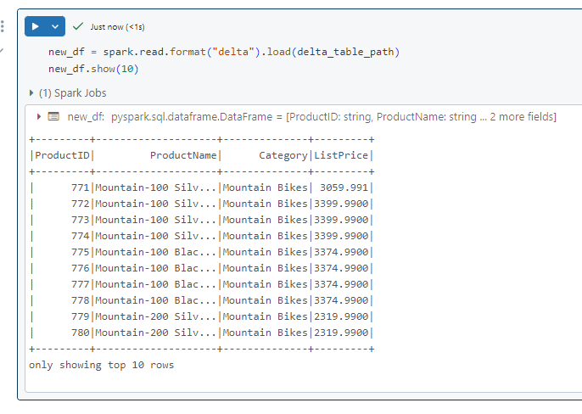

Slide 11
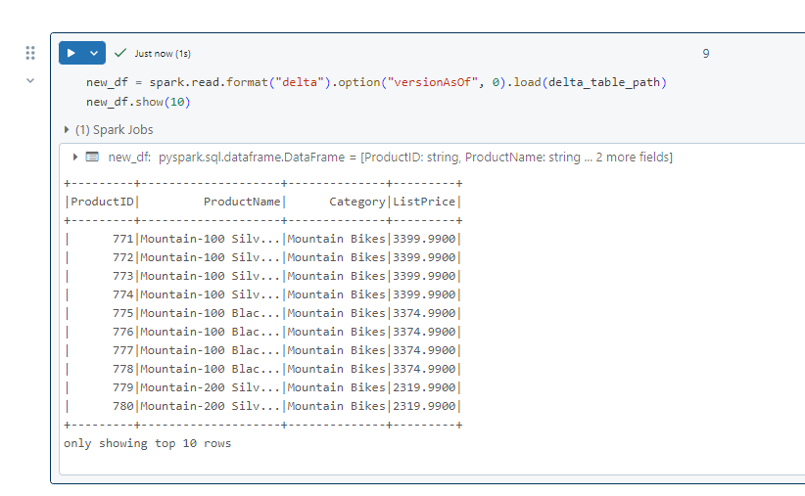
Explore logging and time-travel

Slide 12
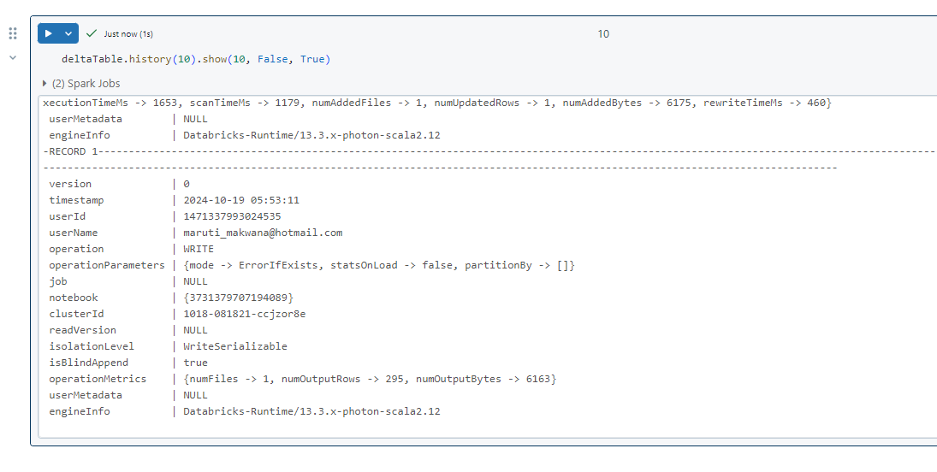

Slide 13
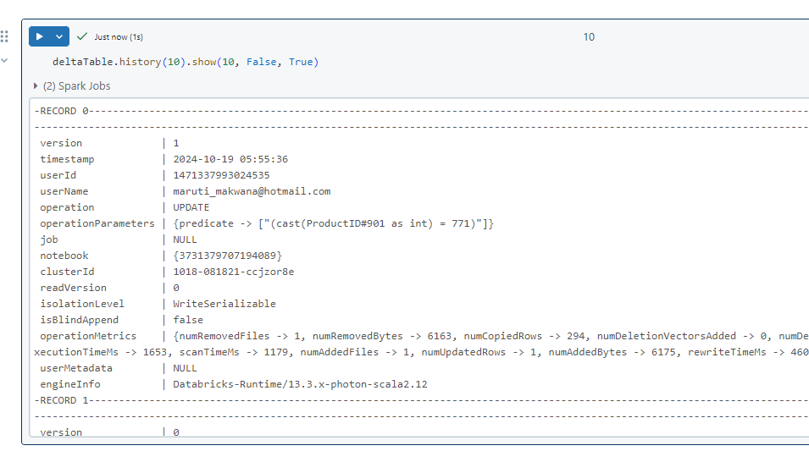

Slide 14
Create catalog tables

Slide 15
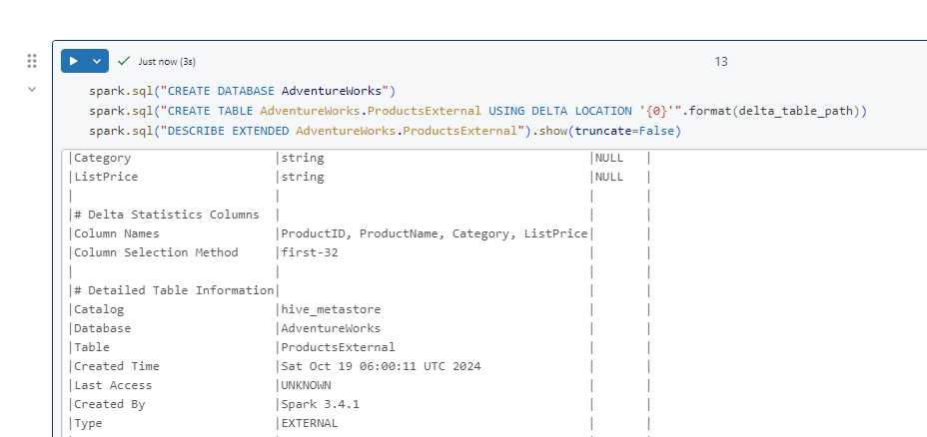
Create an external table

Slide 16
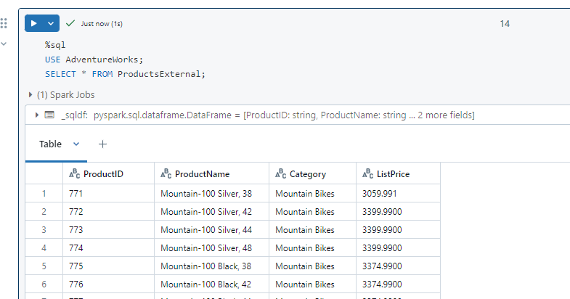

Slide 17
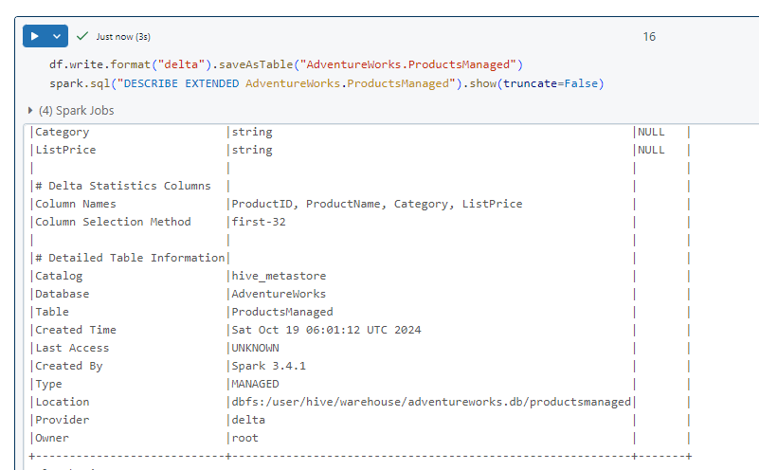
Create a managed table

Slide 18
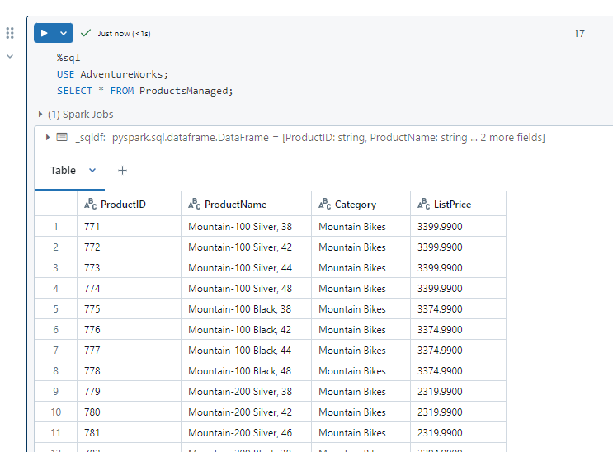

Slide 19
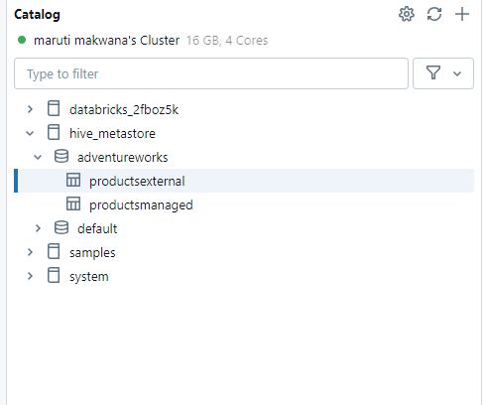

Slide 20
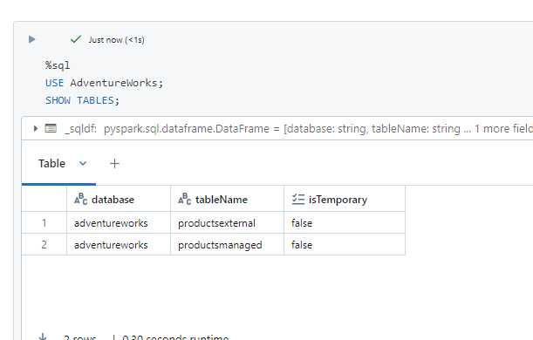
Compare external and managed tables

Slide 21
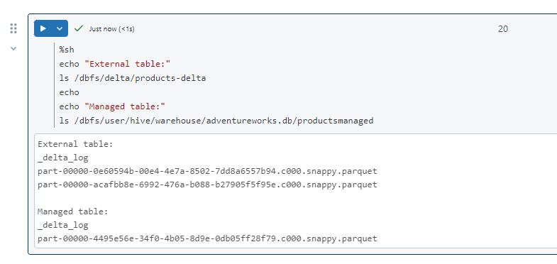

Slide 22
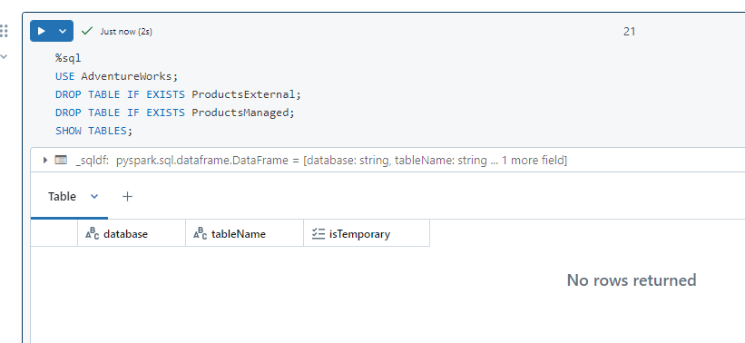

Slide 23
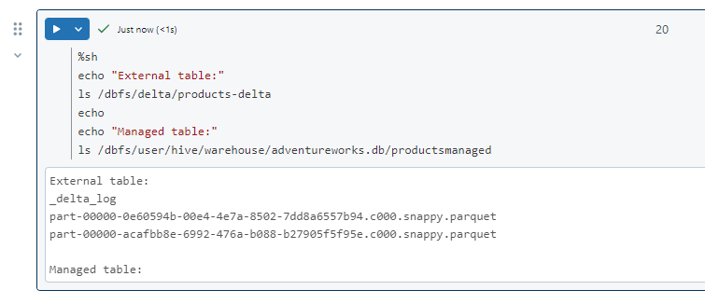
Now rerun the cell containing the following code to view the contents of the delta folders:

Slide 24
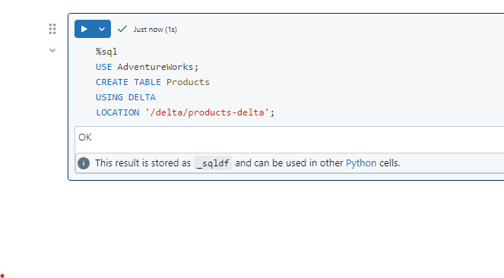
Use the following code to create a new table in the database that is based on the delta files in the products-delta folder:

Slide 25
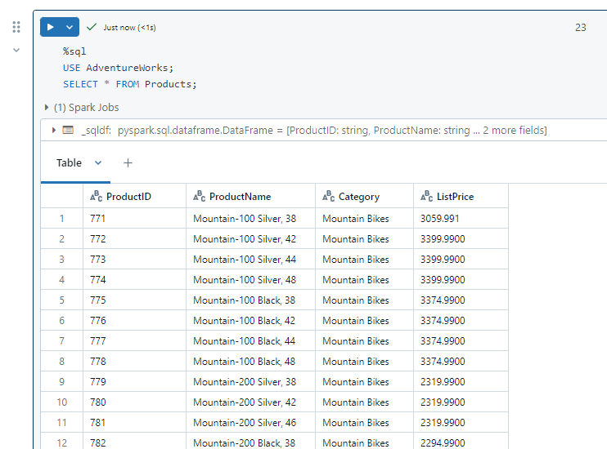

Slide 26


Optimize table layout
the following code to optimize the layout and clean up old versions of data files in the delta table

Slide 27


Slide 28
Real-time Ingestion and Processing with Spark Structured Streaming and Delta Lake with Azure Databricks
https://microsoftlearning.github.io/mslearn-databricks/Instructions/Exercises/DE-01-Real-time-ingestion.html

Slide 29
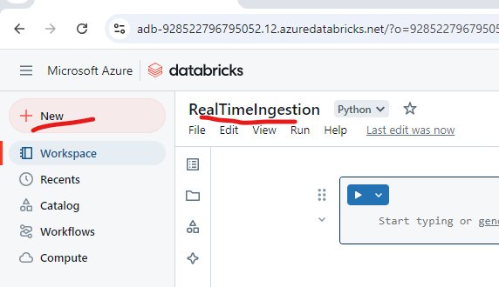

Slide 30
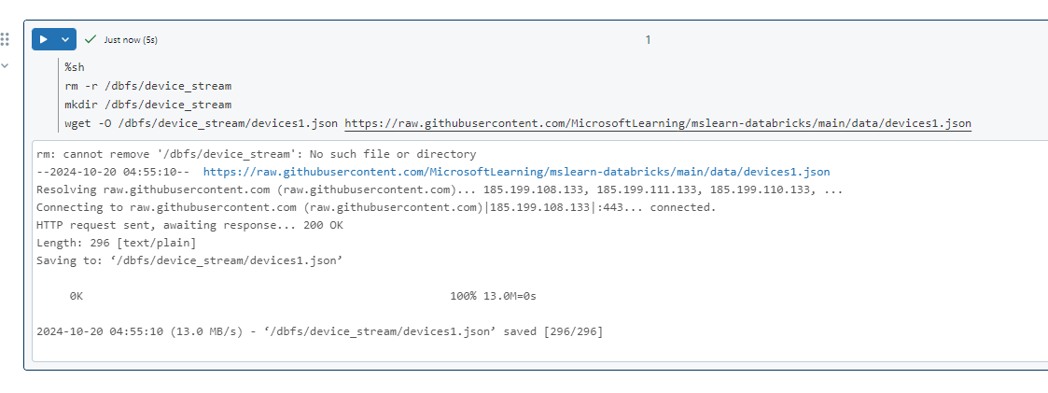

Slide 31
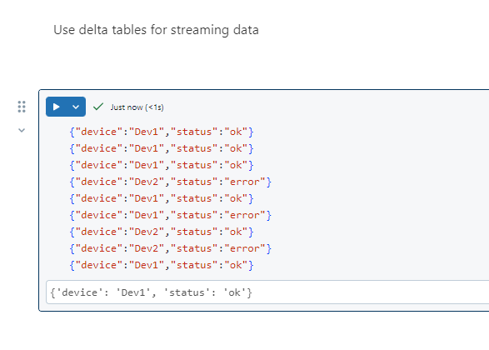

Slide 32
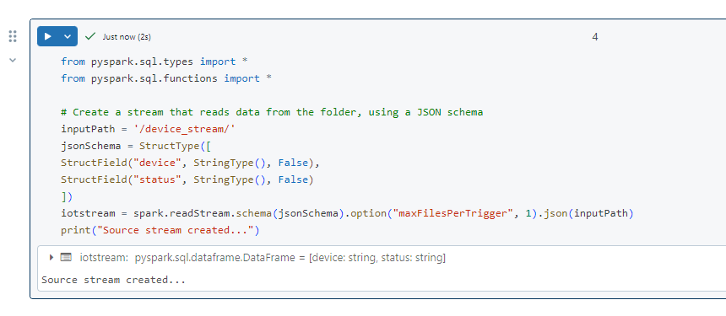

Slide 33
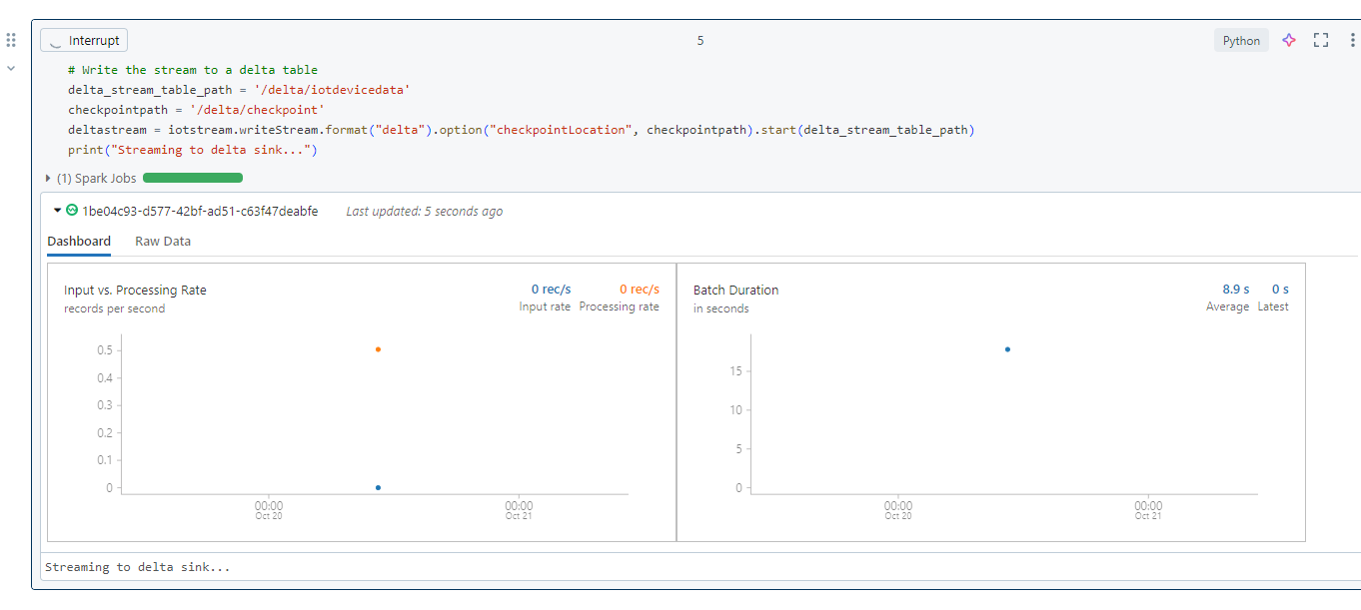


Slide 34
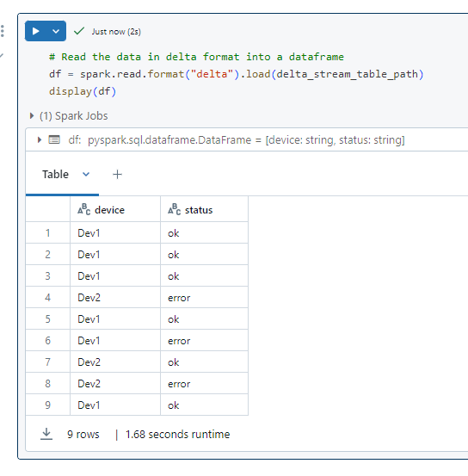

Slide 35
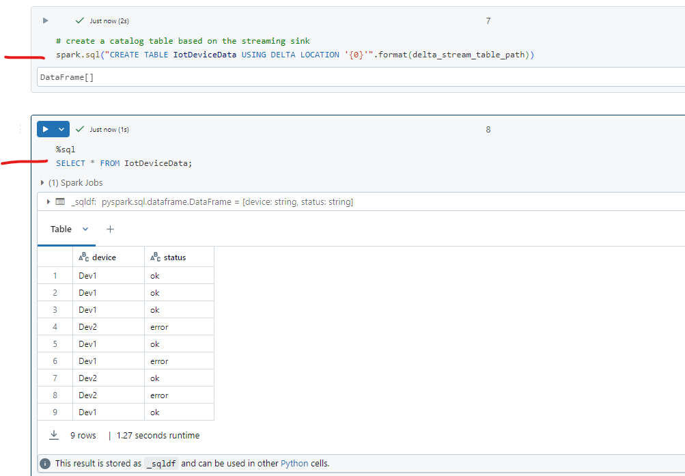

Slide 36


Slide 37
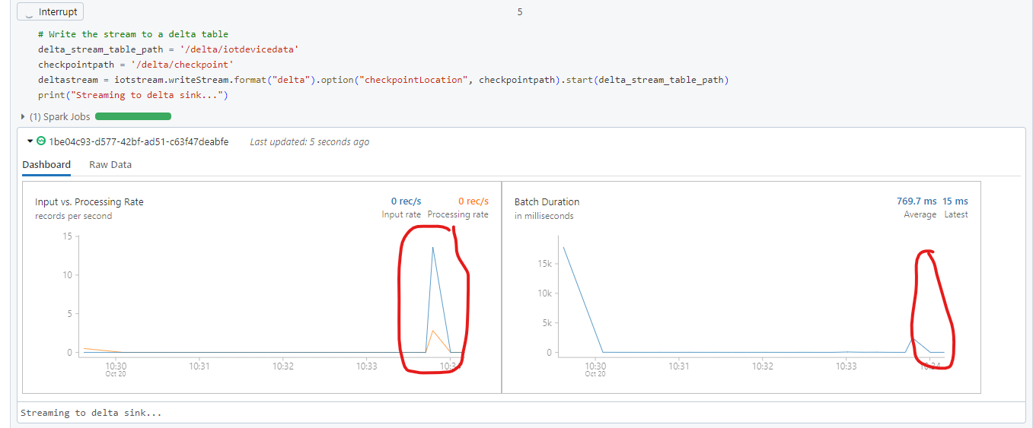

Slide 38
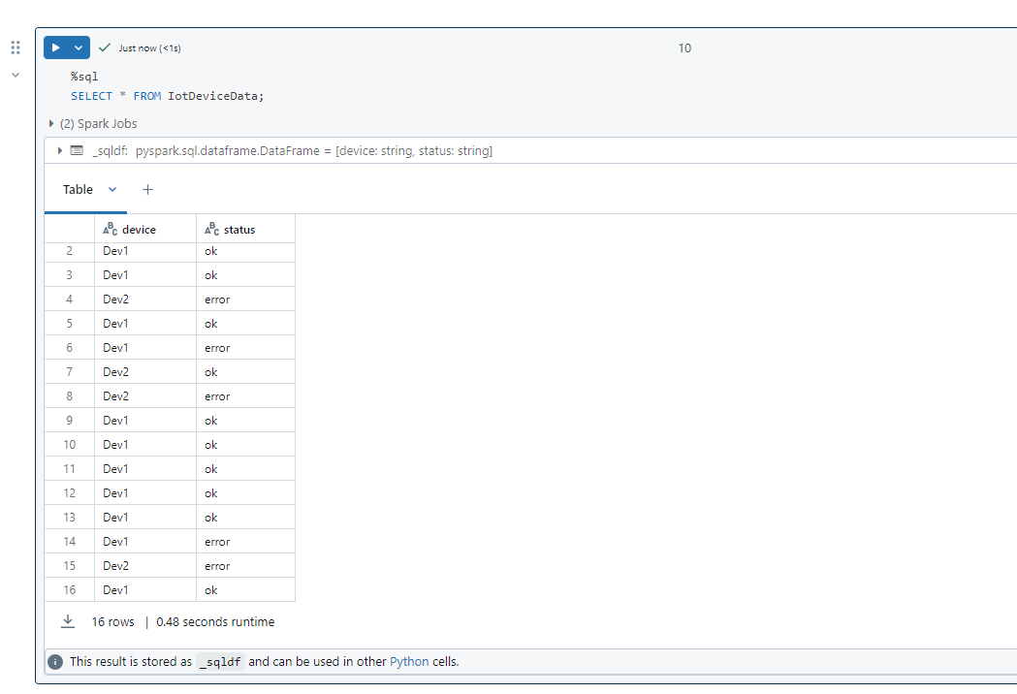

Slide 39


